Slide 1

CAP489 MOBILE APP DEVELOPMENT FRAMEWORKS

Slide 2
Topics Covered
Introduction to Function
Function Syntax,
Void Return Type,
Function with Parameters,
Optional Parameters,
Default Parameter,
Rest Parameter

Slide 3
Function Syntax
function functionName(parameters) {
// Block of statements
}
// Function Definition
function getResult() {
console.log("Hello kumar");
}
// Function Call
getResult();

Slide 4
void Return Type:
function getResult(): void {
console.log('Hello kumar');
}

Slide 5
Function with Parameters:
function multiply(a: number, b: number): number {
return a * b;
}

Slide 6
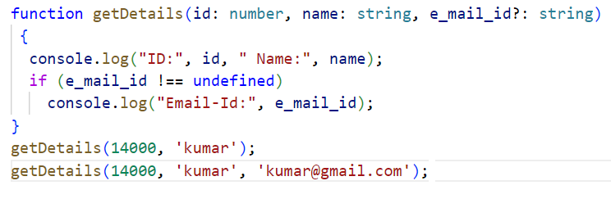

Optional Parameters
We can define optional parameters in function, so if parameter is not required then no need to use. Only we have to put ? With parameter to make parameter as optional.

Slide 7
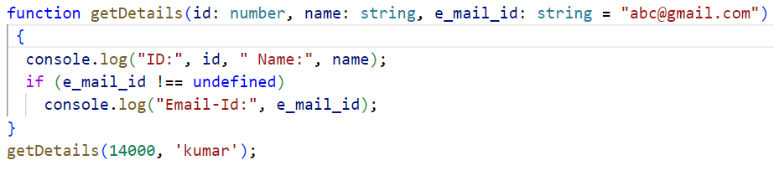

Default Parameter:
An option to set default values to the function parameters

Slide 8
Rest Parameter:
The rest parameter is used to pass zero or more values to a function. We can declare it by prefixing the three "dot" characters ('...') before the parameter. The rest parameter is useful, where we have an undetermined number of parameters.
Rules to follow in rest parameter:
Only one rest parameter is allowed in a function.
It must be an array type.
It must be the last parameter in a parameter list.

Slide 9
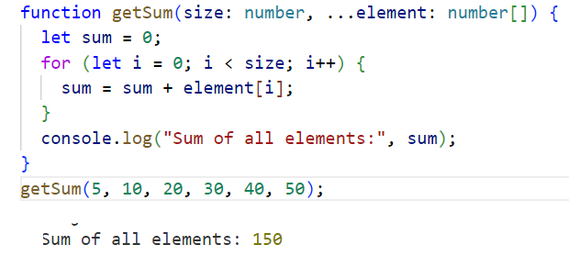

Slide 10

Class
Class is a collection of similar types of objects.
For example: Fruits is class of mango, apple , orange etc.
Fruits

Slide 11
Class is a collection of data members and member functions.
Employee
employeeId employeeName
getDetails() setDetails()
Class Name
Data member
Methods

Slide 12
Example
Syntax:
class <class_name>{
fieldname: fieldType;
methodName:returnType{
}
}
class Employee{
private empName: string;
public getName():void{
console.log(this.empName);
}
}

Slide 13
Creating an object of class
Syntax
let object_name = new class_name(parameter)

Slide 14
A constructor is used to initialize an object. In TypeScript, the constructor method is always defined with the name "constructor." In the constructor, we can access the member of a class by using this keyword.
//defining constructor
constructor(id: number, name: string)
{
this.id = id;
this.name = name;
}

Slide 15
Encapsulation
We can achieve this to make data members as private and to access these private data members using setter and getter accessor methods which should be public.

Slide 16



Inheritance: reusability
father
mother
child

Slide 17
Inheritance
One class can be derived from other class.
We can make the relationship between the classes.
We can re-use the functionality of classes
We can use different form of inheritance
Base Class
Derived Class

Slide 18
Bank Account Hierarchy
Base Class: Account with properties like balance, accountNumber, and methods like deposit() and withdraw().
Subclasses: SavingsAccount, CreditAccount, inheriting common attributes and adding specific rules (e.g., interest rates, transaction fees, credit limits).
Account
balance

Slide 19
Inheritance: types of inheritance
A
A
A
B
B
B
Single
C
C
Multilevel
Multiple

Slide 20
A
A
B
C
B
C
Hierarchical Inheritance
D
Hybrid Inheritance

Slide 21
interface
Interfaces define properties, methods, and events, which are the members of the interface. Interfaces contain only the declaration of the members. It is the responsibility of the deriving class to define these members.
An interface can be extended by other interfaces. In other words, an interface can inherit from other interface. Typescript allows an interface to inherit from multiple interfaces.

Slide 22
We can declare an interface as below.
interface interface_name {
// variables' declaration
// methods' declaration
}

Slide 23
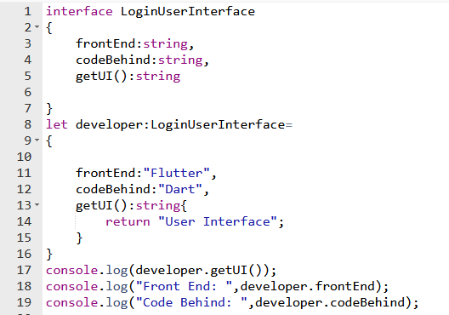

Slide 24
Interface in a class
TypeScript also allows us to use the interface in a class. A class implements the interface by using the implements keyword. We can understand it with the below example.

Slide 25
Any query?

